Slide 1
ASTRONOMY FORUM WEBSITE (BITSPACE)
Team members:
SANJANA MISHRA (18BCE2324)
ANURAG PARCHA (18BCE2335)
SNEHA PREM KIRON (18BCI0249)

Slide 2
Introduction

Slide 3
Motivation
With the growing interest of many people in Astronomy and space research, we have observed that not many platforms exist that cater to these specific needs.
As Astronomy is heavily based on region, we have observed there are few to none websites which exist that help amateur or experienced astronomers and people in general who are interested in Astronomy in India.
We are planning to design a website to do exactly the same.

Slide 4
Summary of the project (abstract )
The website will be mostly a forum-based style, where users will be able to post their questions and similarly give answers to other people with questions about astronomy and any space related topics.
The Website will also contain a News facility to provide the users with updated news and information related to astronomy and space. News from ISRO/NASA/ROSCOSMOS and many other space agencies will also be available.
Any astronomical events for instance, information on eclipses, comets, etc can be provided. Website will also include a login service and make users unique to their website IDs.
We are also going to include links to buying trusted astronomical equipment products such as telescopes.
For Future Development, we can also implement a built-in service in the website to gather the user's GPS information and give accurate weather data and star chart data based on their location in the country or the planet.

Slide 5
Objectives

Slide 6
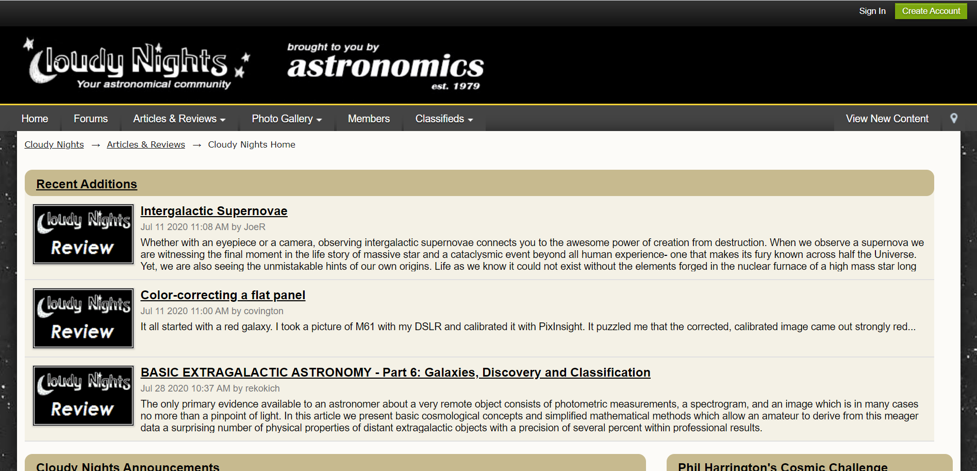
Compare your work V/s existing work
There exists a website called CLOUDY NIGHTS
Cloudy Nights is a forum which also features articles and reviews.

Slide 7
We aim to incorporate more features into our website. These include:
A provision for our users to get in contact with an exclusive Dealers (future enhancement).
Allow for users to send in their stargazing images which we will incorporate into the Gallery.
For Future Development, we can also implement a built-in service in the website to gather the user's GPS information and give accurate weather data and star chart data based on their location in the country or the planet.

Slide 8
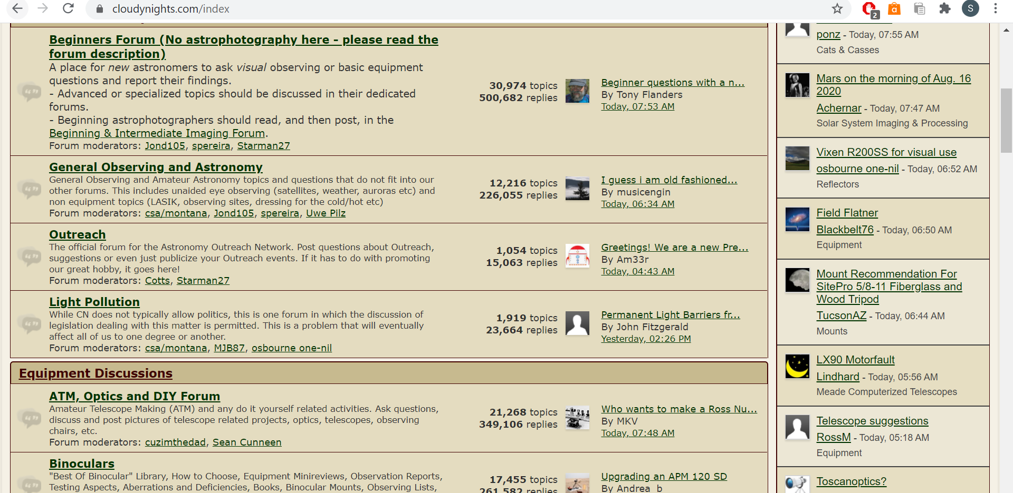
Further, our website will have a fairly modern and clean feel to it that will provide for a pleasant user experience (as the Cloudy Nights website seems monotone and slightly of putting with the tan shade overall.)

Slide 9
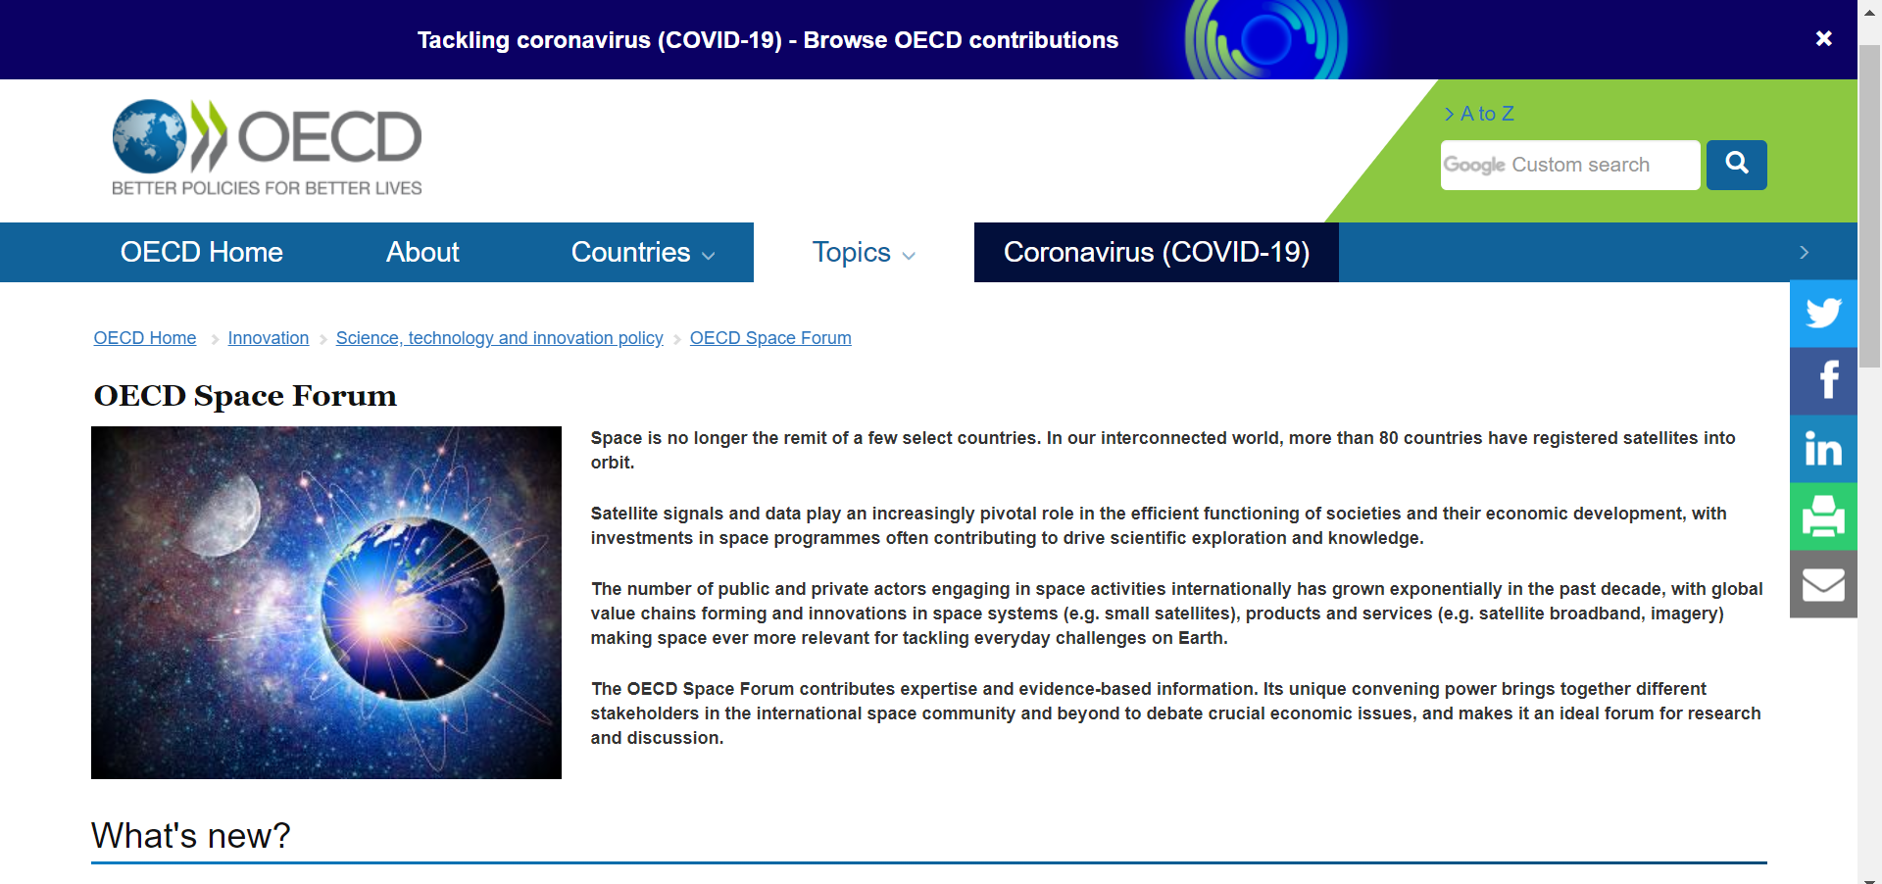
There also exists a platform called OECD Space Forum

Slide 10
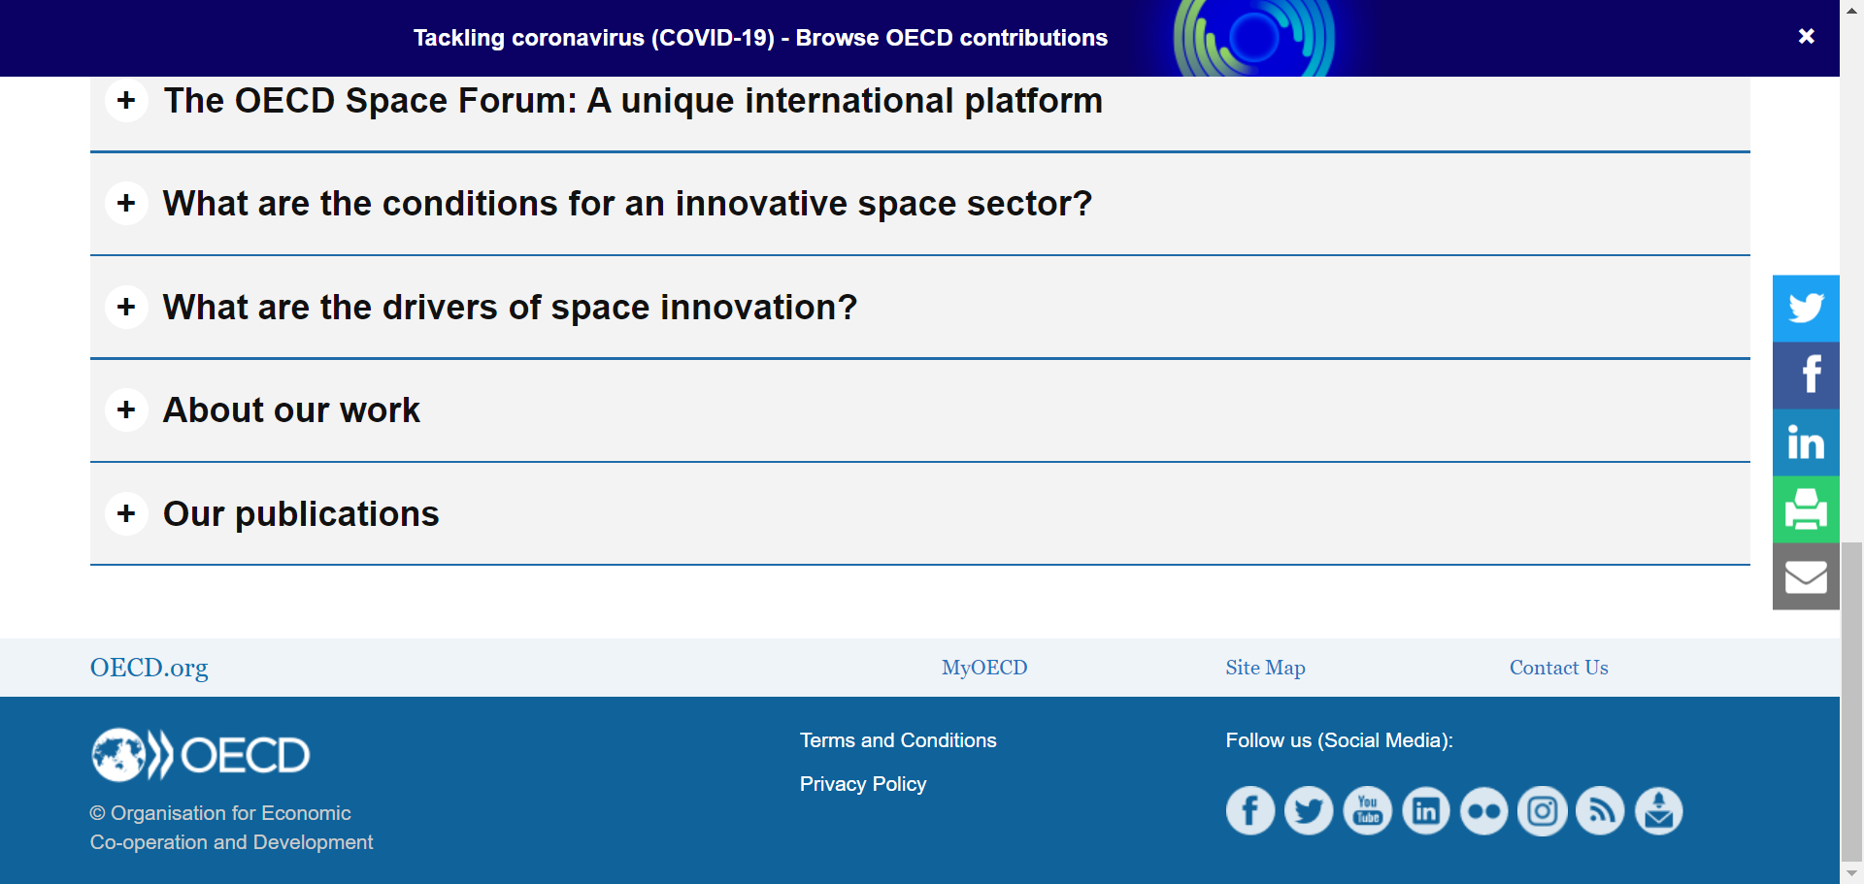
Again, OECD provides news, articles and publications; very similar to Cloudy Nights.
The addition of inclusion of links to buying trusted astronomical equipment products such as telescopes, is what sets us apart from OECD.

Slide 11
Client & End users of the system
The following are the clients or users of our system:
Space enthusiasts
Astronomers
Anyone interested in viewing or buying Astronomical Equipment
Anyone individual keen on discussion
Maharashtra based Equipment store

Slide 12
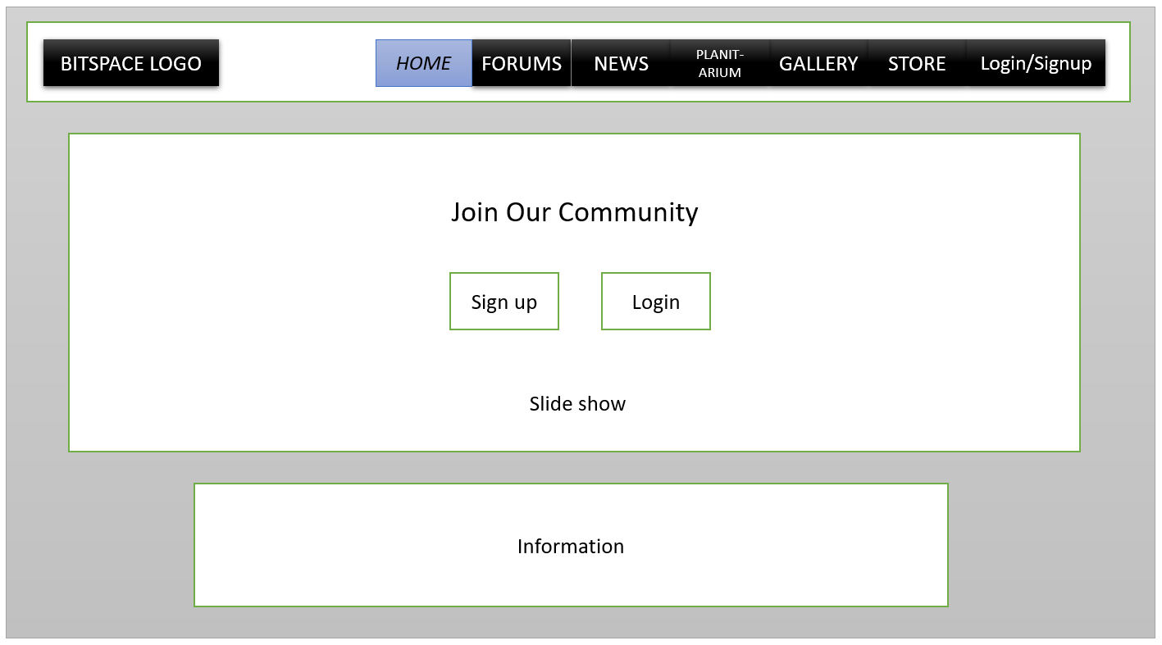
Prototype of the complete system: Landing Page

Slide 13
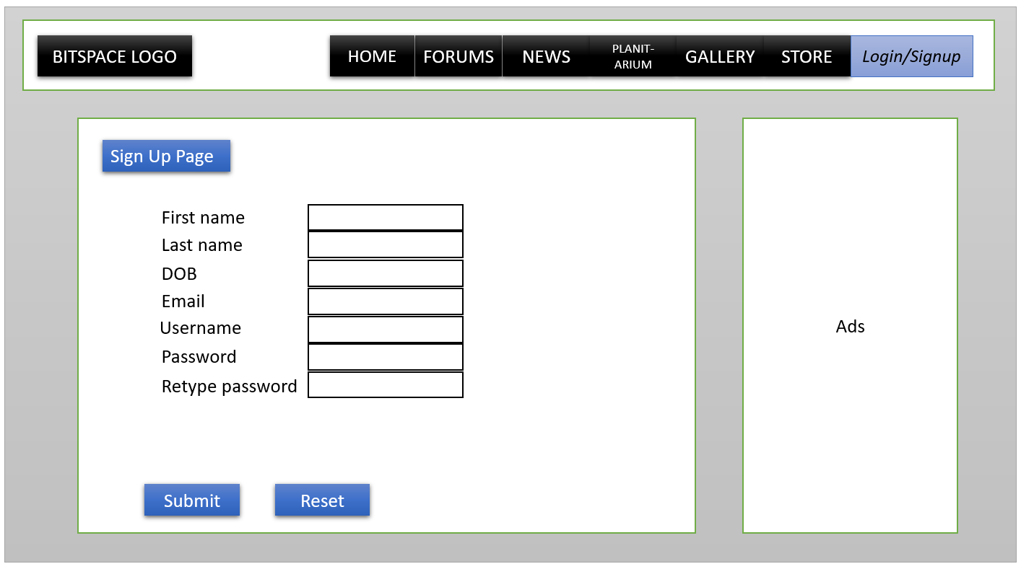

Slide 14
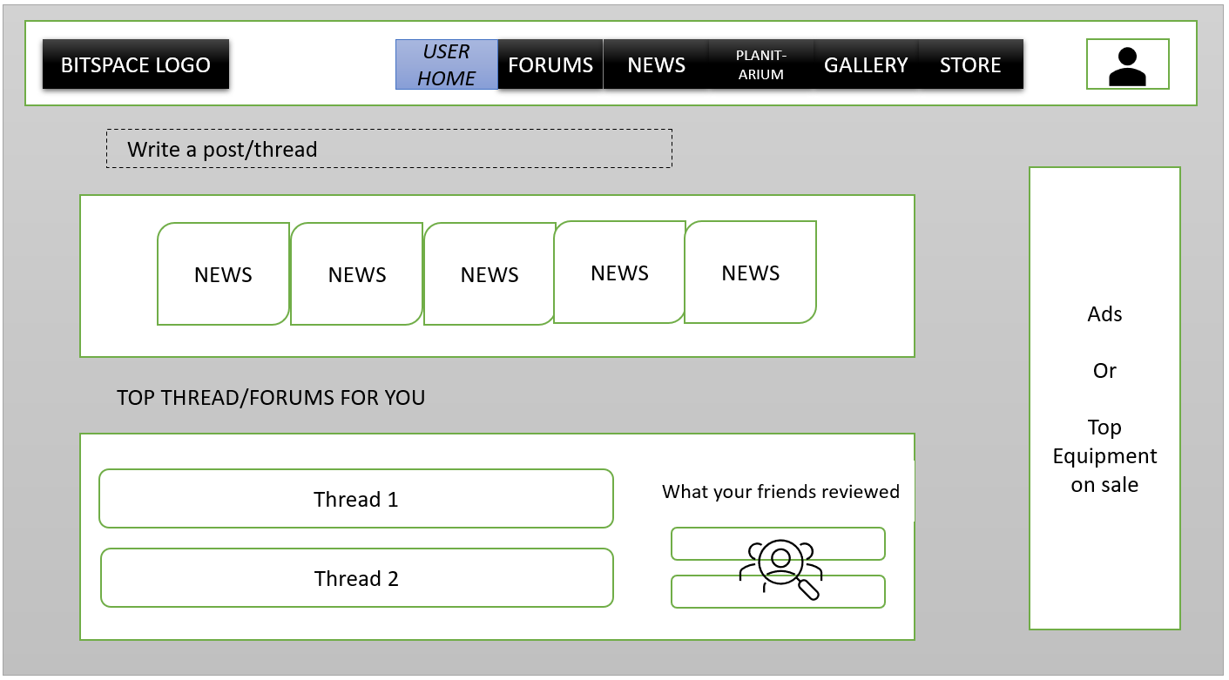

Slide 15
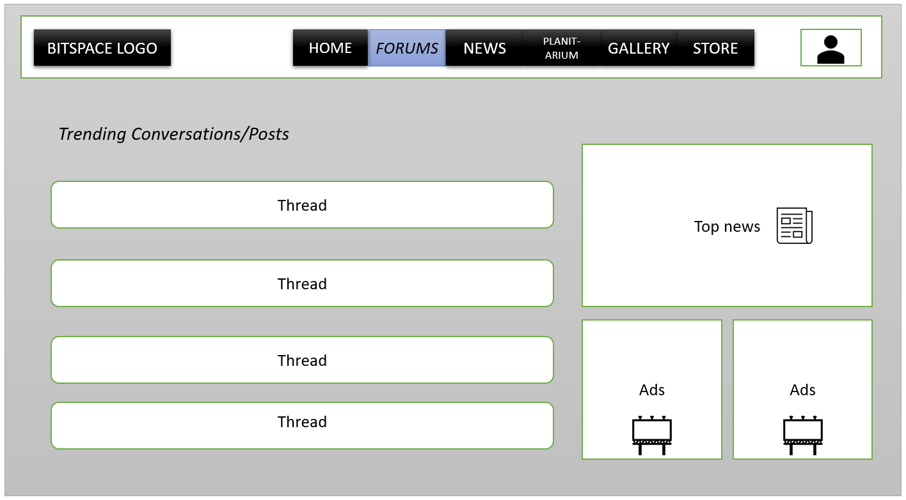

Slide 16
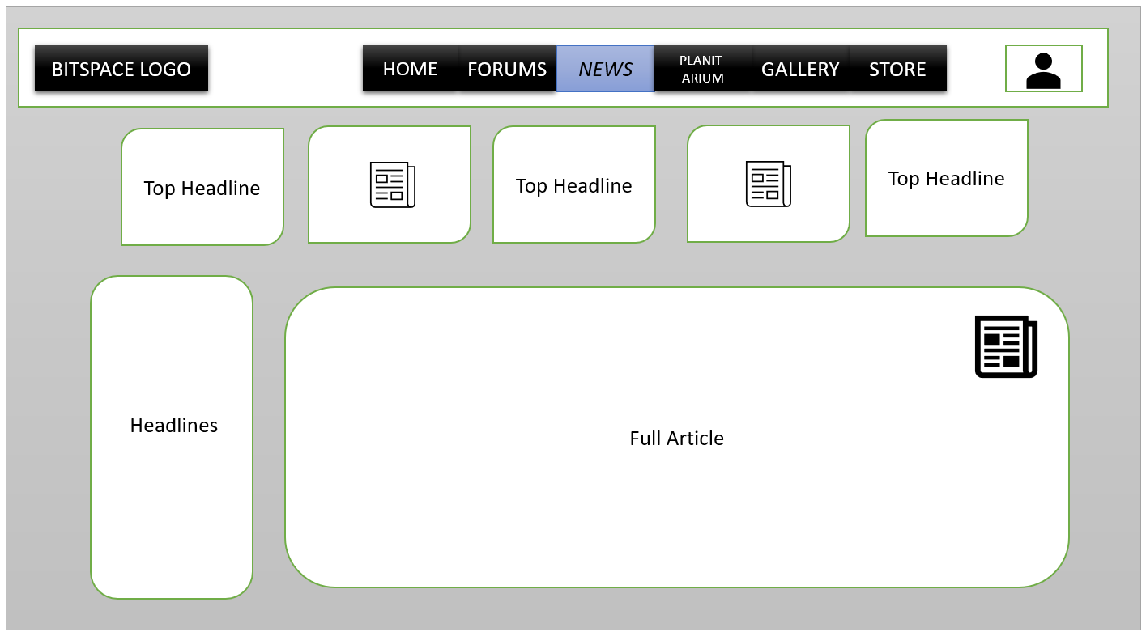

Slide 17
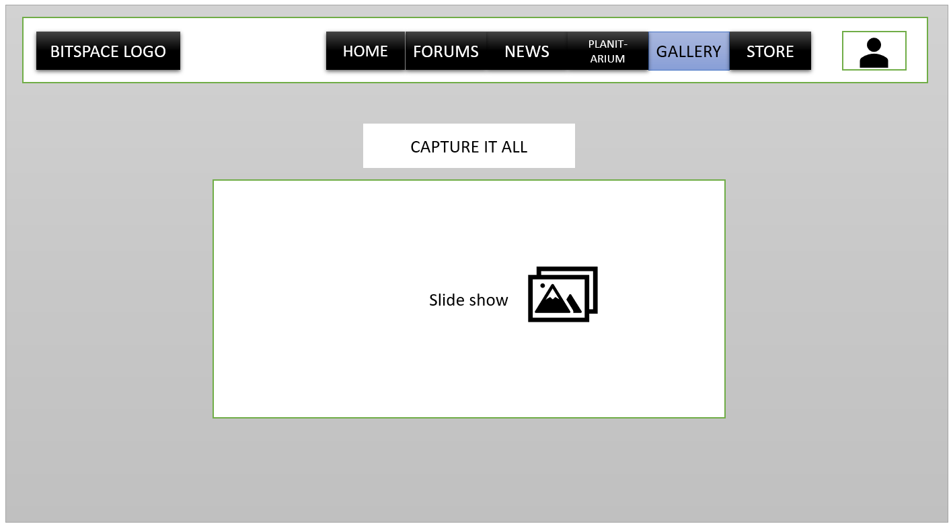

Slide 18
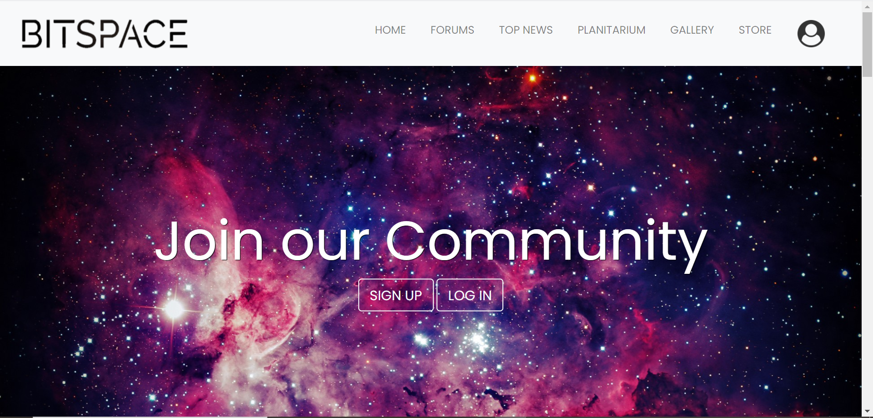
Landing page

Slide 19
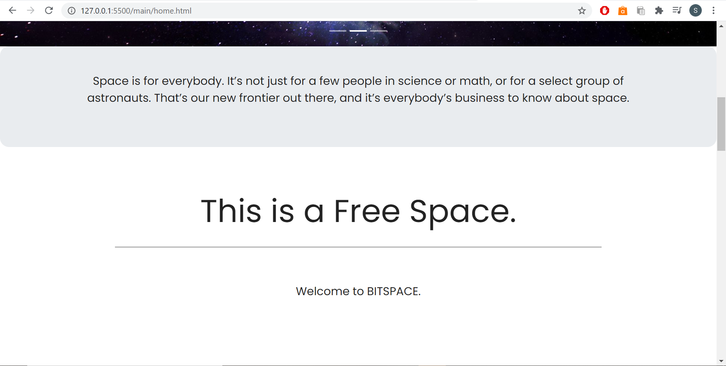

Slide 20
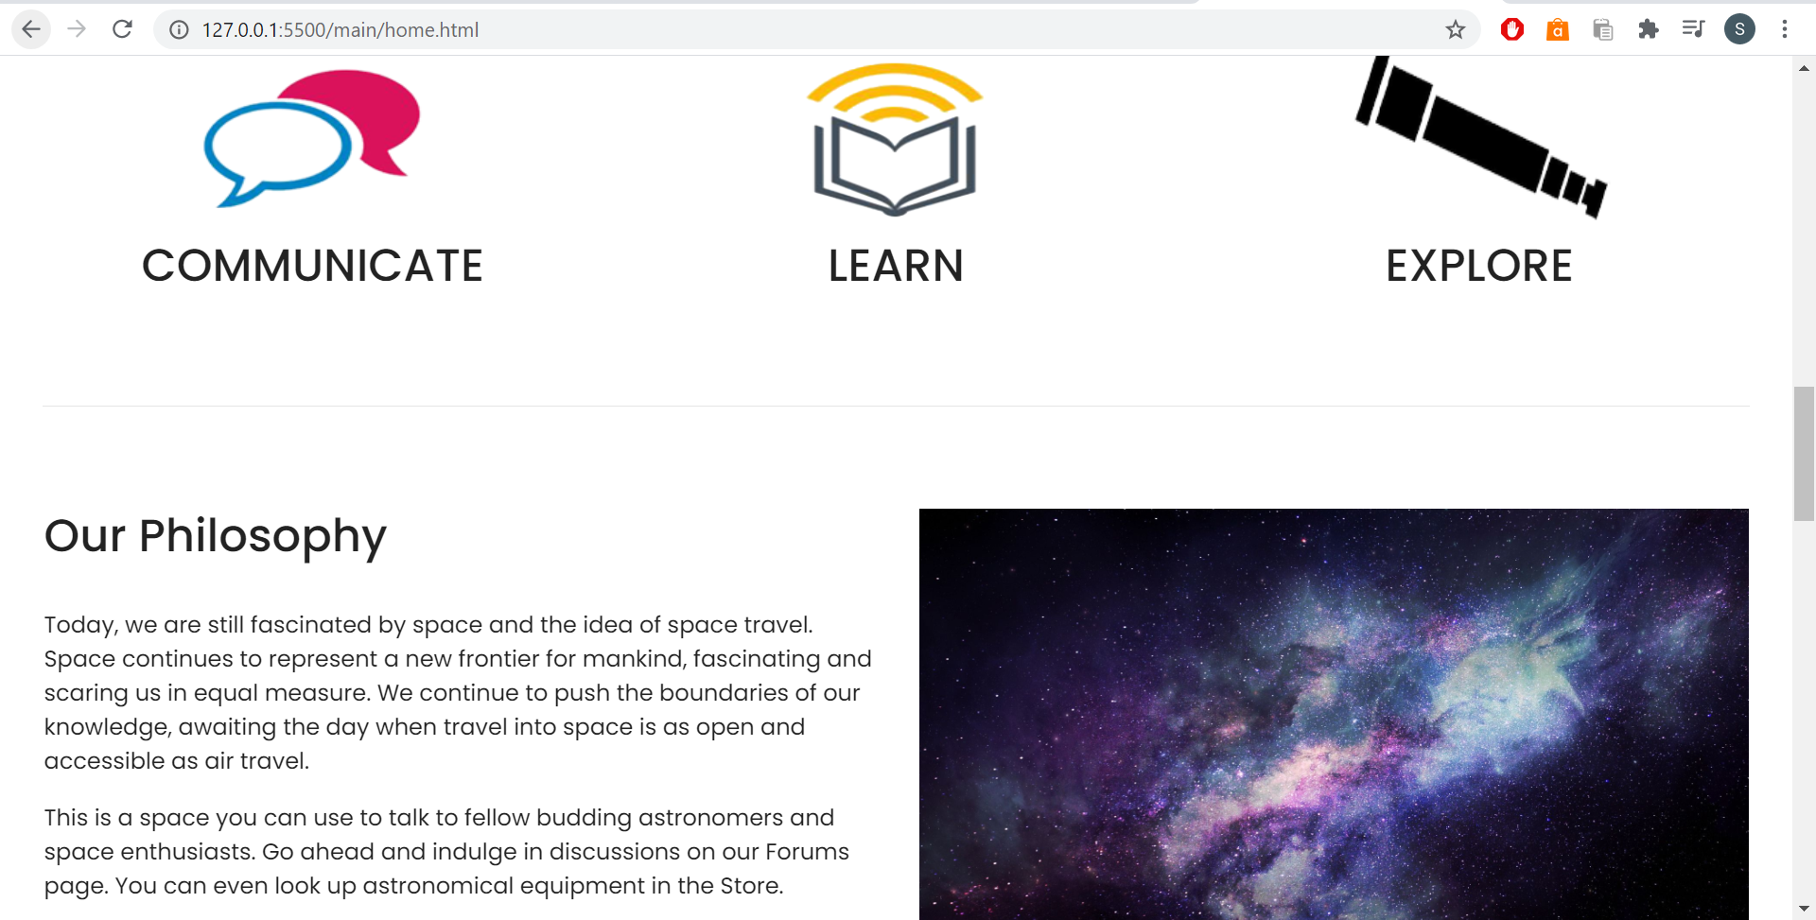

Slide 21
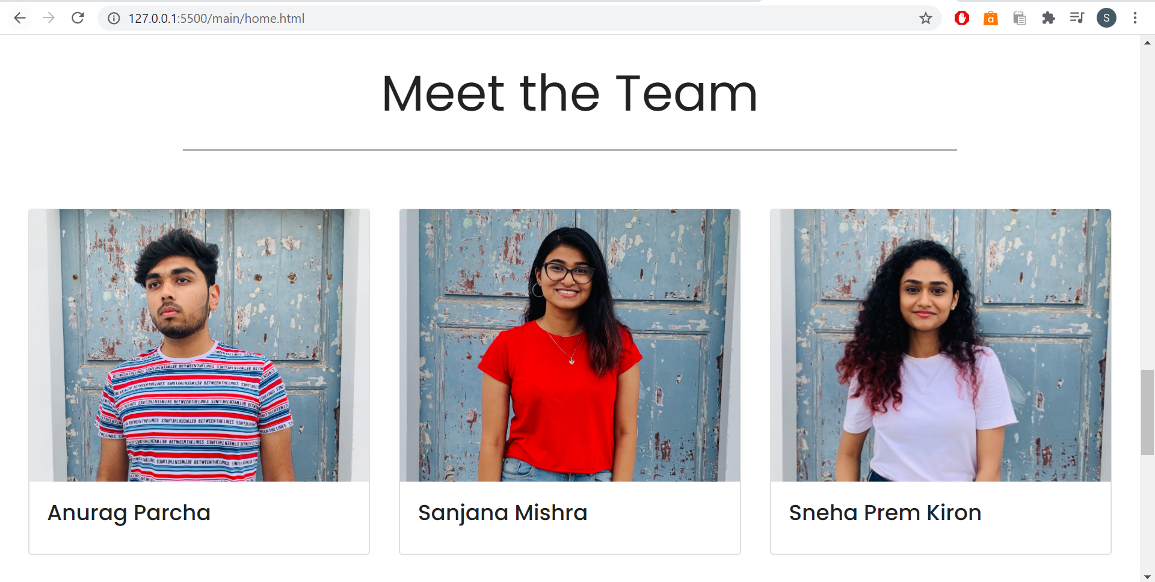

Slide 22
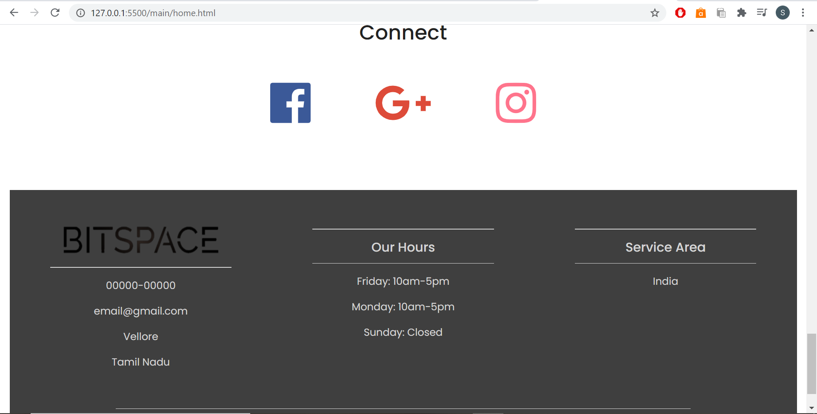

Slide 23
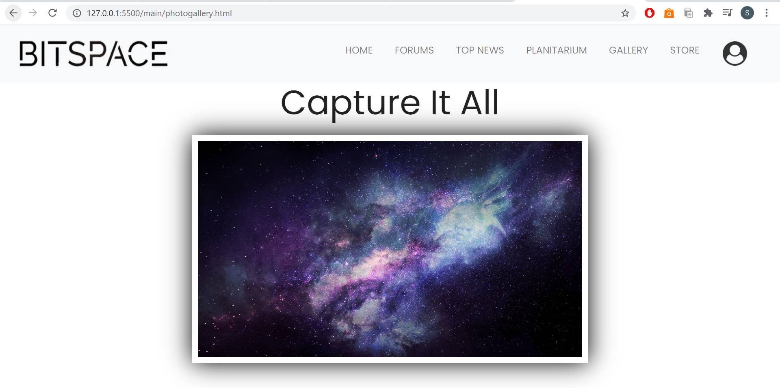
Photo gallery page

Slide 24
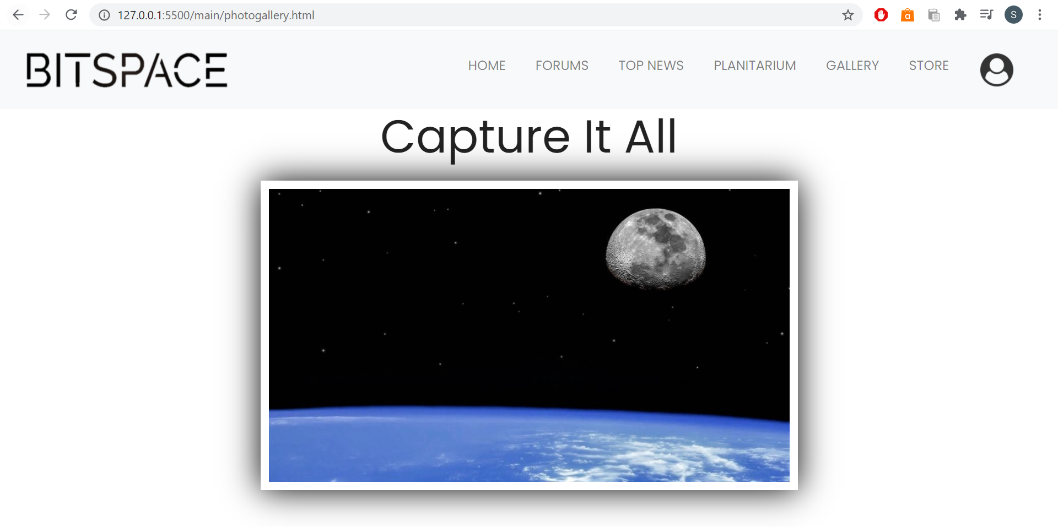

Slide 25
References
https://www.cloudynights.com/index
http://www.oecd.org/innovation/inno/space-forum/
https://www.websitebuilderexpert.com/building-websites/
https://www.w3schools.com/html/

